Slide 1






Mr. Nerd
By Lina & Reem
Mr. Nerd
spec
By:
Lina Alfawzan.
Reem bandar.

Slide 2


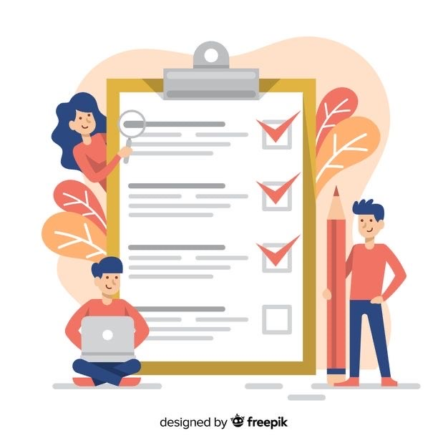
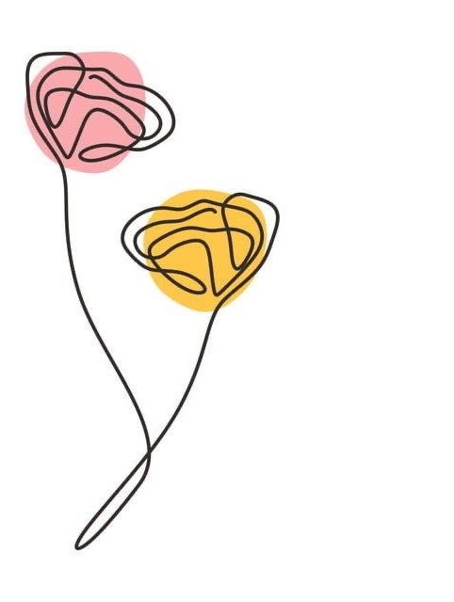
Content:
Mr. Nerd
By Lina & Reem
Introduction.
Project idea.
Methodology.
Component of the GUI.
Parameters: option & methods.
Implementation.
Testing.

Slide 3



Mr. Nerd
Introduction
By Lina & Reem
Our project is GUI for a chatbot program using tkinter package.
tkinter is a standard Python interface to the Tk GUI toolkit shipped with Python.
Python with tkinter is the fastest and easiest way to create the GUI applications.

Slide 4




Project Idea
Mr. Nerd
By Lina & Reem
It is a chat bot to answer math questions, provided with a GUI to facilitate and clarify the program to the users.

Slide 5
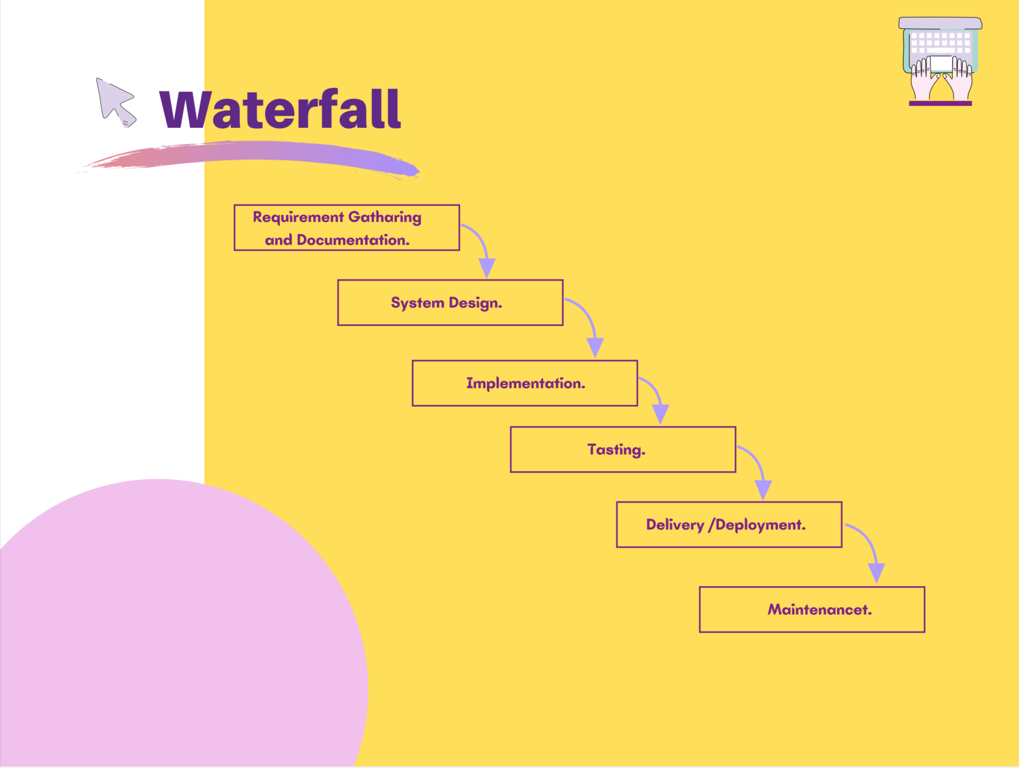
Mr. Nred
By Lina & Reem
methodology

Slide 6


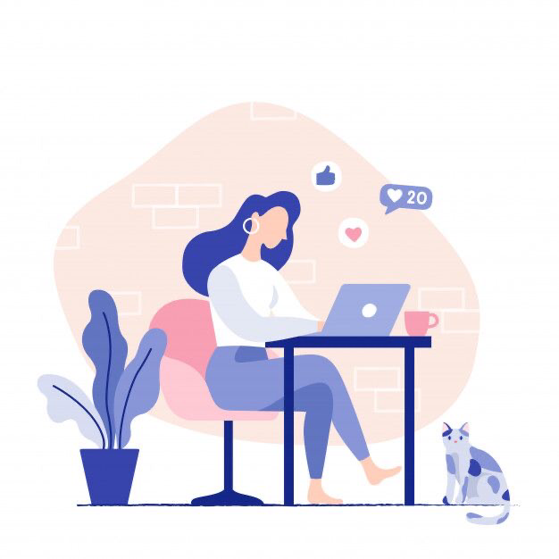
Mr. Nerd
By Lina & Reem
Component of the GUI
Root window.
Background.
Labels for place a text & picture.
Entry field.
Commbox.
Button.
Frame.
Scroll bar.
Icon

Slide 7
Option &method
bg: the normal background color displayed behind the label and indicator. | height: vertical dimension of the frame. Default is 10.
bd: the size of the border around the indicator. Default is 2 pixels. | relief: selects three-dimensional border shading effects. The default is SUNKEN.
cursor: the cursor that appears when the mouse is over the widget. | width: the width of the frame. Default is 20.
font: the font used for the text. | yscrollcommand: if you want to allow the user to scroll the content vertically.
fg: the color used for the text. | yview(): to make the content vertically scrollable, set the command option of the associated vertical scrollbar to this method.
Mr. Nerd
By Lina & Reem

Slide 8

Mr. Nerd
By Lina & Reem
Implementation:
1- Import the packages:
2- Create a root-level windowing:
3- Build all your GUI components within root-level window:
tkinter.
pyttsx3.
chatterbot.
from tkinter import *
root = Tk()
It is contain the GUI components and functionality.
tkinter provides various components called widgets, such as entry field.
e.g.:
user_input = Entry(root,font=('times new roman',15),width= 50, bd=1,relief=GROOVE)

Slide 9
Mr. Nerd
By Lina & Reem
Implementation:
4- Connect these GUI components to underlying program code:
5- Geometry management using pack & place:
6- The main event loop:
root.mainloop()
used when your application is ready to run. It is an infinite loop used to run the application.
Via the function that you link it with the widget command.
e.g.: askButton = Button(root, command=ask_bot)
To display the widget in size it requires.
e.g.:
smlLabel.place(x=0, y=72)
ChatBox.pack(pady=15)

Slide 10
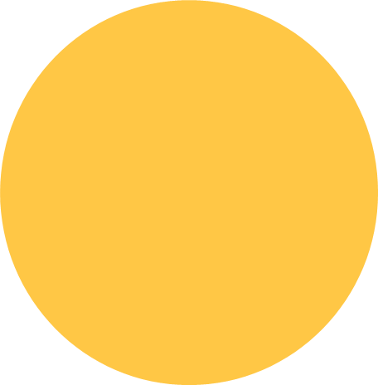

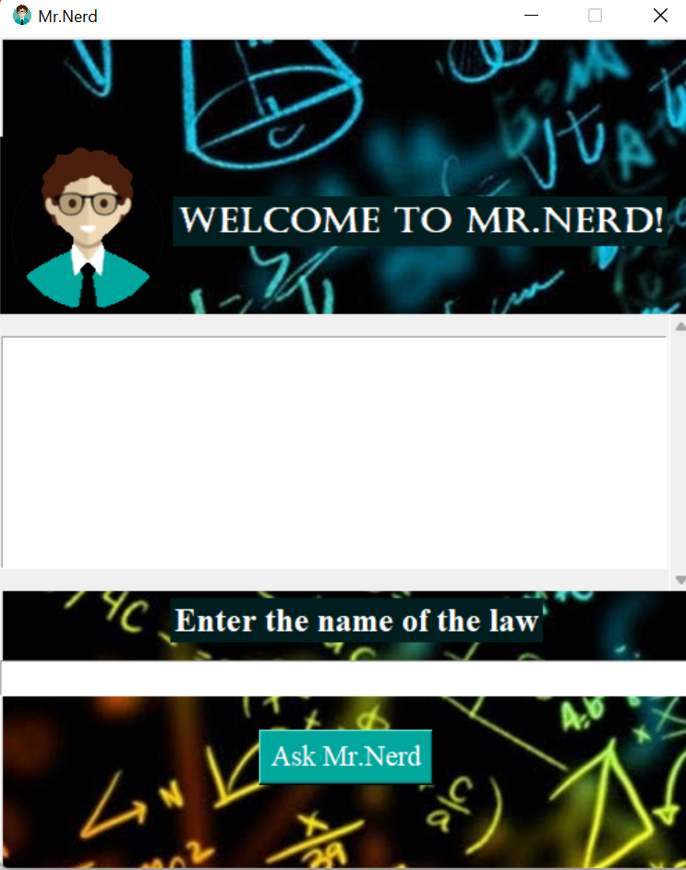
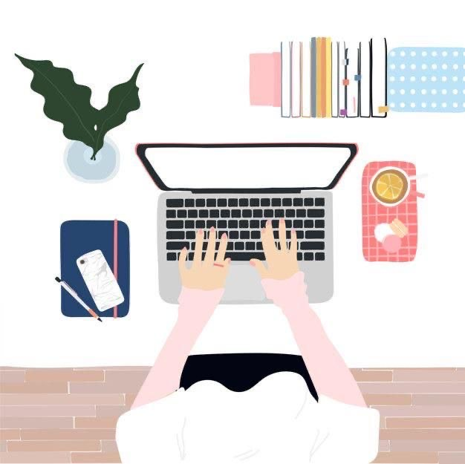
Testing
Mr. Nerd
By Lina & Reem
NOW
will be try it together!

Slide 11


Mr. Nerd
By Lina & Reem
THANK YOU!

